Slide 1


Ways to Make Physical Fitness Fun and Easy!

Slide 2
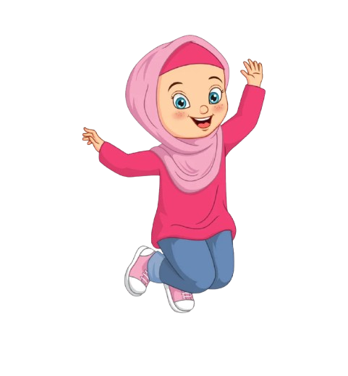
Recap- Why is Physical Fitness important again?
Helps with physical development
Improves mental health
Improves cognitive function
Helps with disease prevention
Improves cardiovascular health
Good for weight management

Slide 3

The Holy Prophet Muhammad(pbuh) said:
“A strong believer is better and more beloved to Allah than a weak believer[…]”
(Sahih Muslim)
“…The most beloved deed to Allah is the most regular and constant, even if it were little.”
(Sahih al-Bukhari)

Slide 4
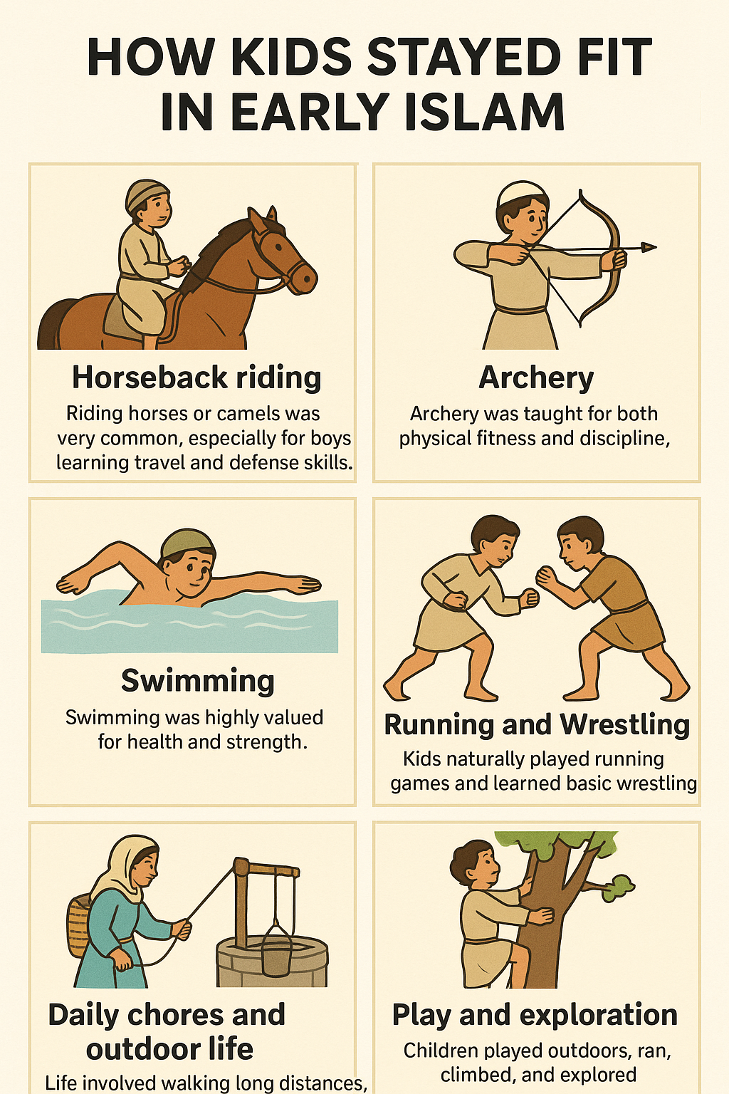
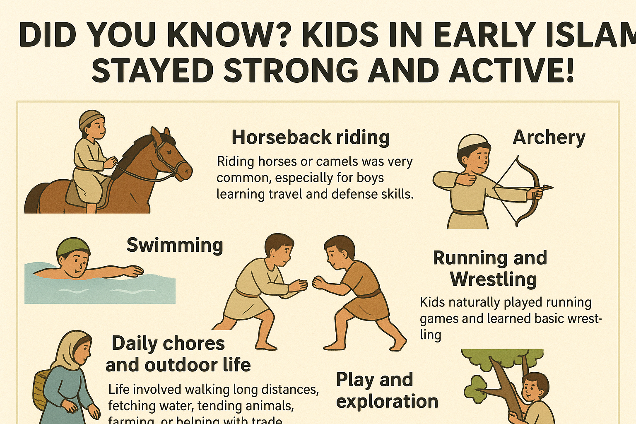
How Kids stayed fit in early Islam

Slide 5
We don’t have to be a member of a sports club to do exercise!
Staying physically fit can be easy when:
It’s (almost) free of cost
You don’t have to wait for your parents to take you
You don’t have to leave your home
You can even do it all by yourself
It’s FUN!

Slide 6
Some Examples:
Walking around the neighborhood
Jump roping (you can even use a scarf)
Making a path with some tape or chalk and walking on it
Bodyweight exercises like jumping jacks, squats, push ups,…
Homemade obstacle courses using chairs, pillows, tape…
Tossing around a ball or a balloon, making sure it doesn’t touch the floor

Slide 7
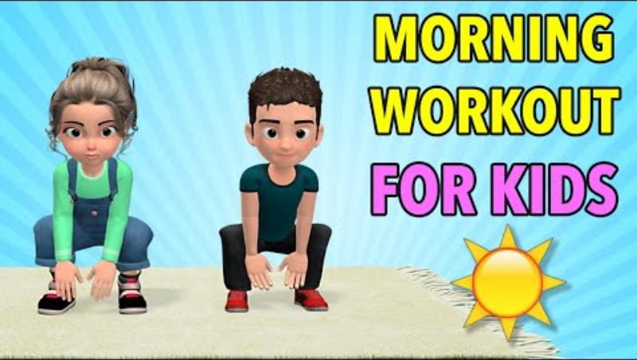


There are many fun workout/yoga videos for kids online.
Here are three examples:

Slide 8
Resources
https://sunnah.com/bukhari:6464
https://www.youtube.com/watch?v=skSbg1IGup8
https://www.youtube.com/watch?v=sP09PYXu8eM
https://www.youtube.com/watch?v=dnwHDN6Dw7Q
https://www.cdc.gov/physical-activity-basics/health-benefits/children.html#:~:text=Physical%20activity%20is%20good%20for,measures%20of%20a%20healthy%20weight.
https://pu.edu.pk/images/journal/jihat-ul-islam/PDF/1-importance%20of%20fittness%20settled%20by%20thanvi.pdf

