Slide 1
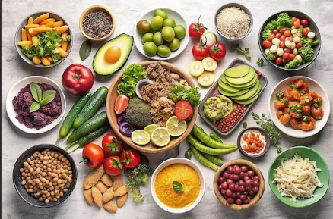

Benefits of Different Foods

Slide 2
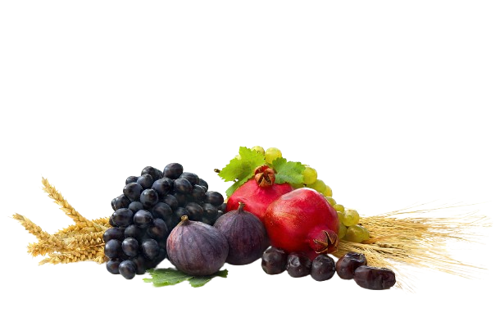
“So eat of the lawful and good things which Allah has provided for you; and be grateful for the bounty of Allah,…” (16:115)
Allah says in the Holy Qur’an:

Slide 3
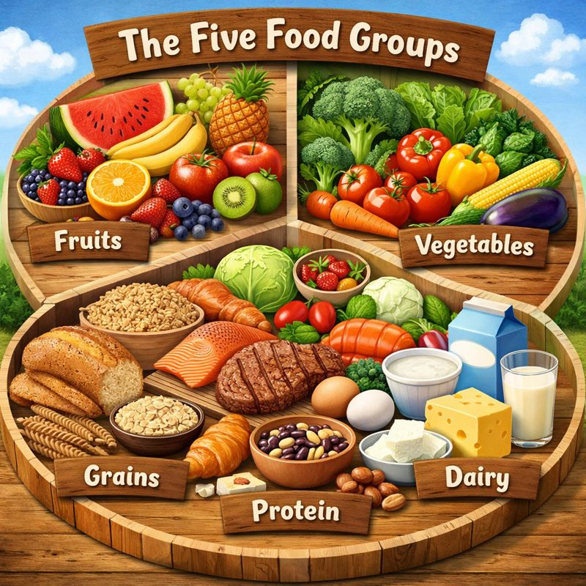
Eating different kinds of foods is not only healthy; it also keeps our meals interesting and flavorful!

Slide 4

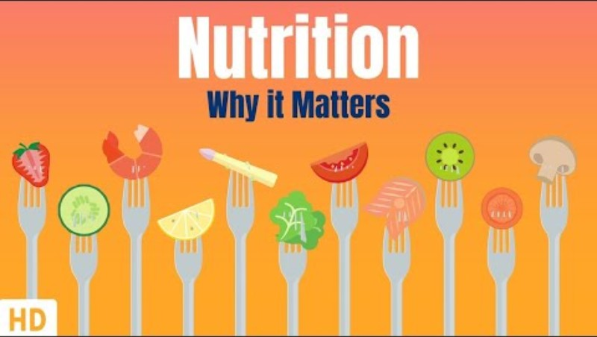
VIDEO

Slide 5


Dates
Olives
Grapes
Pomegrantes
Figs
Bananas
Cucumbers
Wheat
Do you know how many foods are mentioned in the Holy Qur’an?
9. Lentils
10. Onions
11. Herbs
12. Milk
13. Honey
14. Sea food
15.Cattle (cows/sheep/goats/camels)
16. Birds (quail)

Slide 6
Resources:
https://alislam.org/quran/app/1?options=en
https://freejna.dewa.gov.ae/ramadan/foods-mentioned-in-the-quran---english.html
https://www.youtube.com/watch?v=Evji_ebWZQU
https://www.bbc.co.uk/bitesize/articles/zwj7kty

