Slide 1

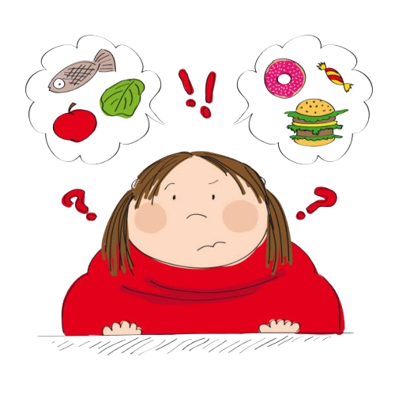
Childhood
Obesity

Slide 2
What is Childhood Obesity?
One of the most common chronic (long-term ) health conditions that affect children
Involves children who are above a healthy weight for their age and height
Approximately 1 in 5 U.S. children and adolescents have obesity
According to studies conducted by the U.S. Centers for Disease Control and Prevention (CDC) from 2017 to 2020, obesity affected about 19.7% of children and adolescents ages 2 to 19
→ That’s about 14.7 million children and adolescents in the US!

Slide 3
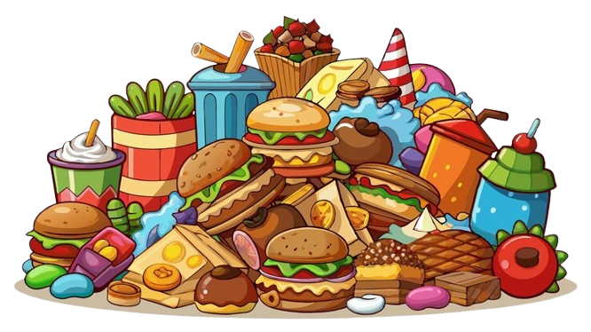
Who is at Risk for Developing Childhood Obesity?
Children who regularily eat foods that are high in sugar and fats (sodas, juices, candy, fast foods…)
Children who do not do enough
physical activity (60 minutes per day)
Genetic predisposition (obesity runs in the family) – but don’t worry: Healthy Habits can help counter this!

Slide 4
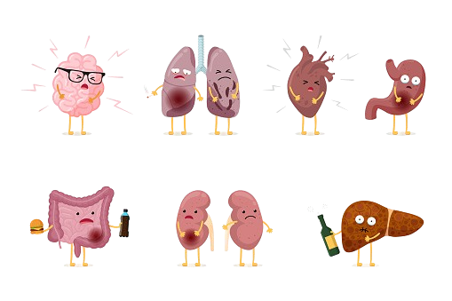
Health Problems that come with Childhood Obesity
Physical Health:
hypertension
high cholesterol
heart disease
type 2 diabetes
respiratory issues
joint pain…

Slide 5
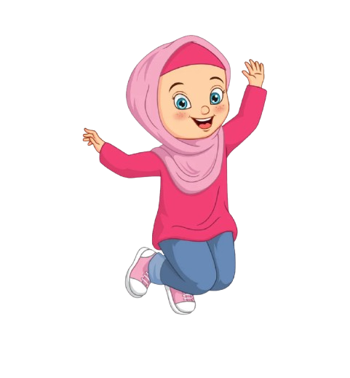
Health Problems that come with Childhood Obesity
Emotional Health:
Potential low self- esteem
Depression
BUT there is no place for blame or guilt about body shape or size!
→ We are all unique and beautiful in our own ways
Focus on body HEALTH, not body appearance!

Slide 6


Being Healthy As A Token Of
Thankfulness
We are blessed that Allah has gifted us bodies that function in
a healthy way
→ So as a token of Gratitude to Allah, we should take care of our bodies!
Allah says in the Holy Qur’an:
“And Allah brought you forth from the wombs of your mothers while you knew nothing, and gave you ears and eyes and hearts, that you might be grateful.” (16:79)

Slide 7
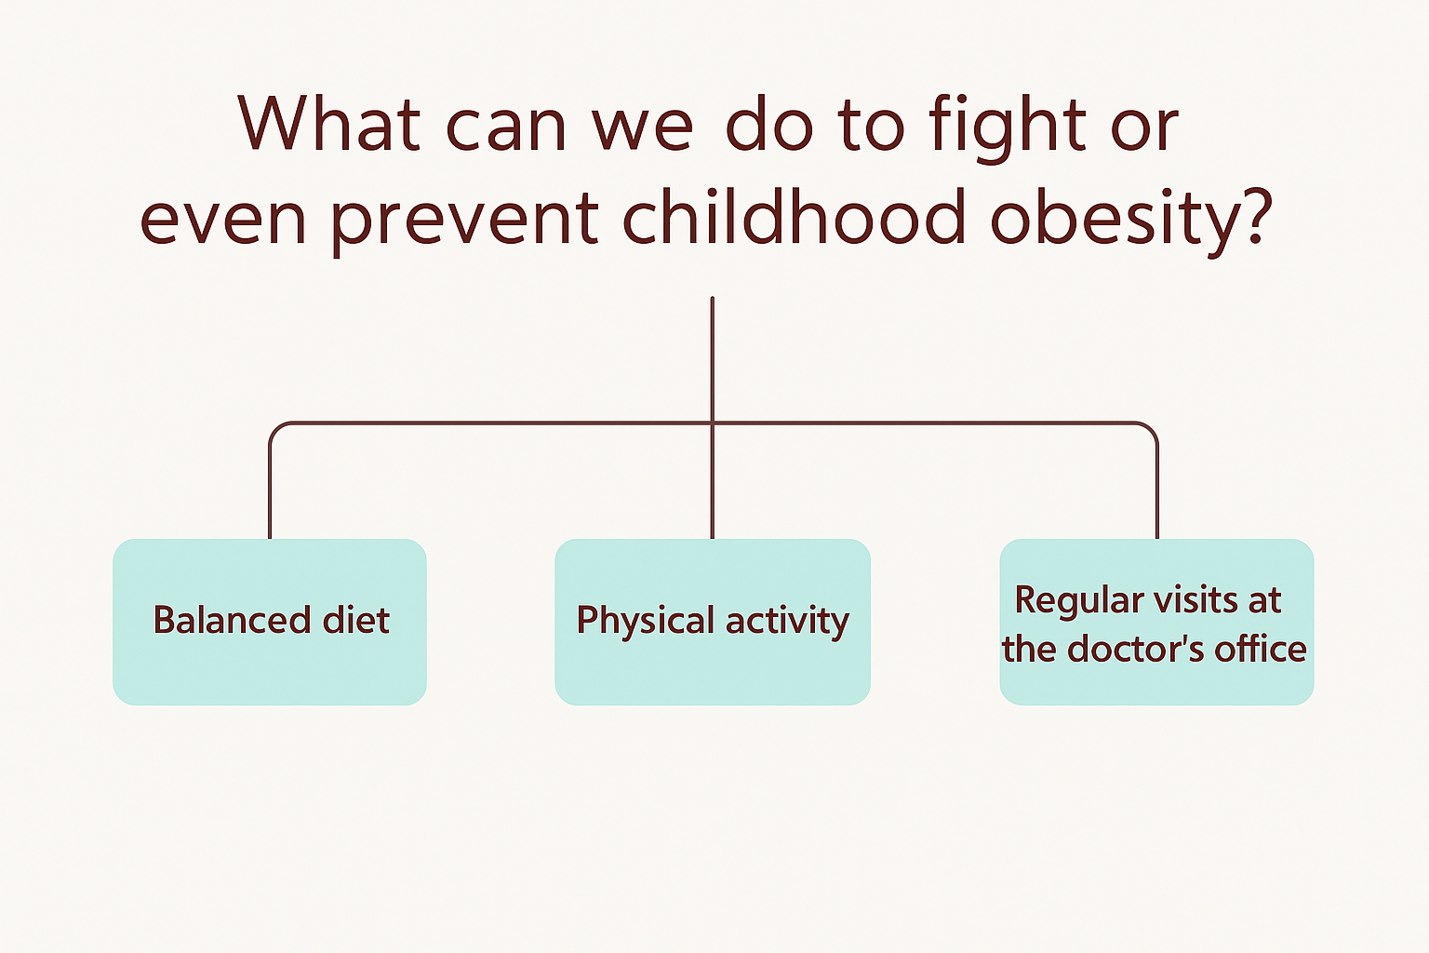


Slide 8


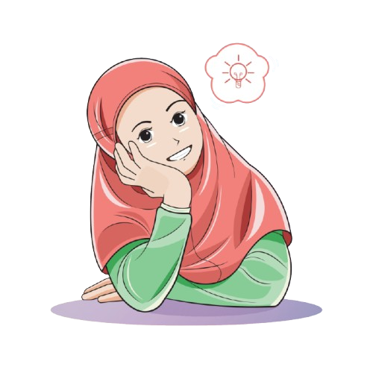
“It’s okay to enjoy ‘unhealthy’ foods
once in a while, as long as we are not
making it a habit.
The Holy Prophet (pbuh) said:
’The best work is one that is done in moderation.’”
(Sahih Al-Bukhari)
“But I like eating foods
that are considered unhealthy.”

Slide 9
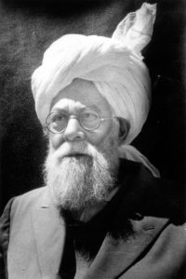
Hazrat Musleh Maud(ra) said:
If the youth does not take care of their health, they will be “reaching old age before enjoying their youth…”

Slide 10
Resources:
The Holy Qur’an
Childhood Obesity: A Complex Disease - HealthyChildren.org
Childhood Obesity: Causes & Problems
Steps to exercise -V3.indd

