Slide 1

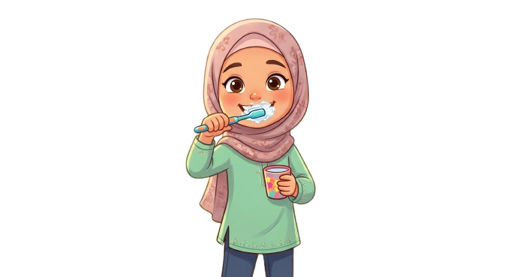
Oral
Hygiene

Slide 2
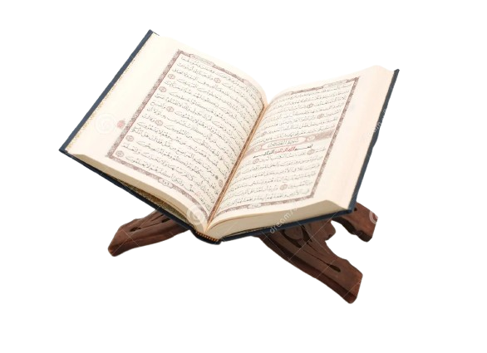

The Importance of Oral Hygiene in the Holy Qur’an:
“Allah loves those who turn to Him and loves those who keep themselves clean.” [2:223]
In Surah Al-Ma’idah, Allah commands us to perform wudoo, which includes rinsing the mouth—showing the importance of oral hygiene in our daily lives.
→ A clean mouth is part of a clean body, and a clean body
is part of our faith.
This Photo by Unknown Author is licensed under CC BY-NC

Slide 3
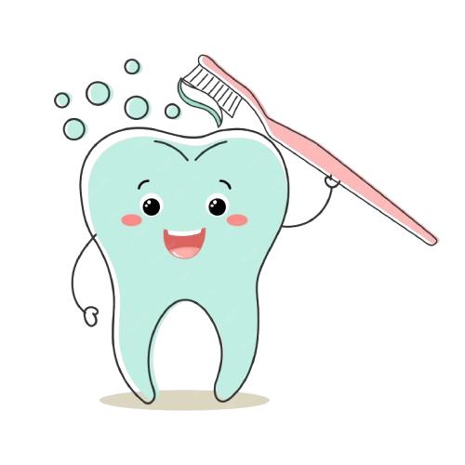
Tooth Health
We should take care of our teeth (permanent teeth) because they are the only ones we get after our baby teeth (primary teeth)!
We should brush at least twice daily (in the morning and before bedtime)
We should floss daily, before brushing
We should have regular dental check ups (every 6 months)
! The foods we consume have an effect on our dental health !

Slide 4
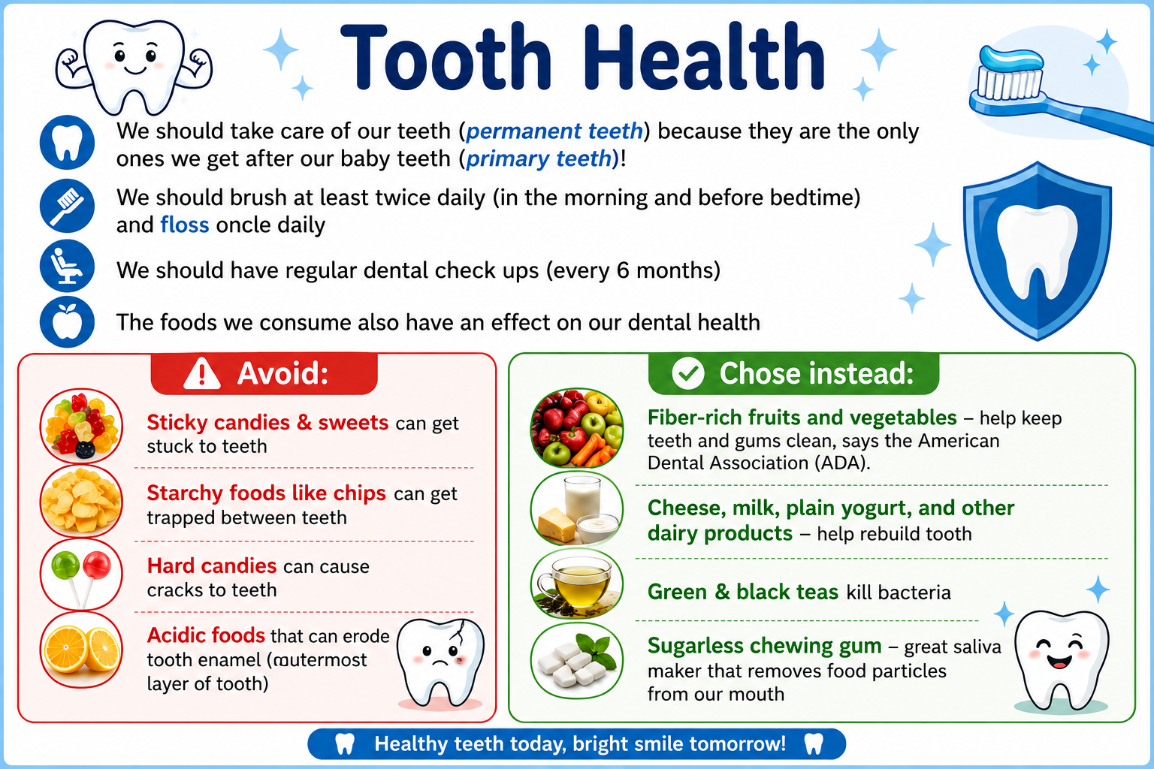
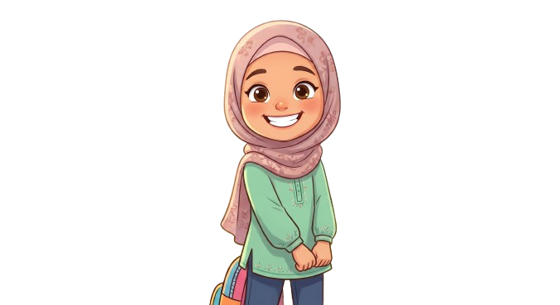
AI-generated image (ChatGPT)

Slide 5
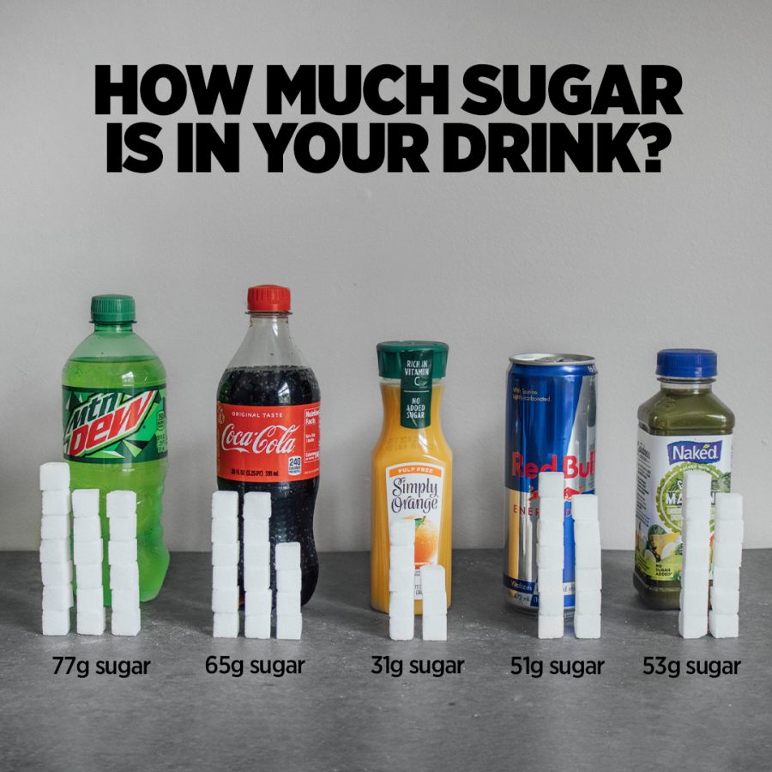
Source: https://meowmeix.com/wp-content/uploads/2021/08/A.drinks.sugar3_-900x900.png

Slide 6
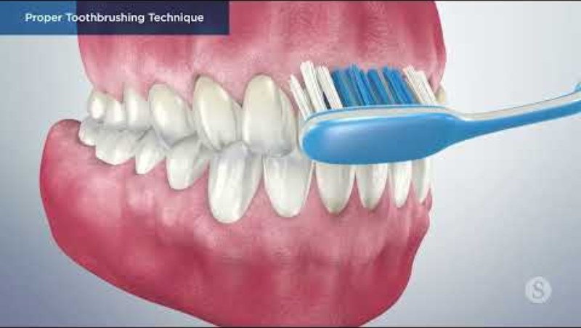
How to Properly Brush Our Teeth

Slide 7
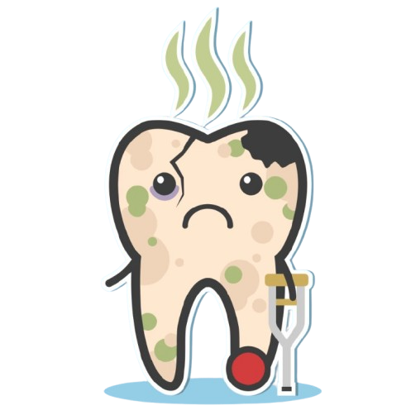
What happens if we don’t take care of our teeth?
Plaque and Tartar Buildup: Plaque is a sticky film of bacteria that forms on teeth. If not brushed away, plaque can harden into tartar.
Gum Disease: A serious tooth infection
Cavities and Tooth Decay: Holes in teeth, occur when bacteria produce acids that erode tooth enamel
Increased Risk of Health Issues: Research shows that poor oral health can be linked to heart disease, diabetes, and respiratory infections.
Chronic Pain and Discomfort: A toothache may start as a minor annoyance but can
escalate into severe pain.
Bad Breath
Tooth loss: Neglecting dental health can ultimately lead to tooth loss.
Impact on Mental Health: The appearance of your teeth plays a significant role in your
self-confidence.

Slide 8
The Holy Prophet Muhammad^{(pbuh)} said:
"If I had not found it hard for my followers, I would have ordered them to clean their teeth with Miswak for every prayer.“ [Sahih al-Bukhari]
→ Meaning : The Prophet^{(pbuh)} emphasized oral hygiene so strongly that he almost made cleaning the teeth before every prayer compulsory.
The Prophet (Muhammad^{(pbuh)}) regularly encouraged the use of the Miswak. [Sahih al-Bukhari]
→ This shows that keeping the mouth clean was a consistent habit of the Holy Prophet Muhammad^{(pbuh)} and of the Muslims at that time.

Slide 9
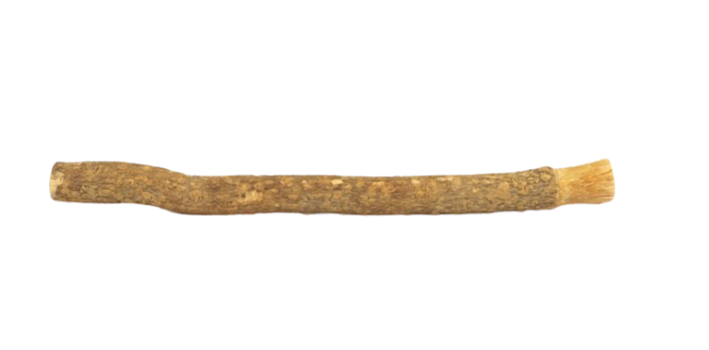
What is a Miswak?
Miswak is a teeth-cleaning twig made from the roots or branches of the Salvadora persica tree (‘arak’ in Arabic).
Miswak’s widespread use is deeply tied to Islamic tradition; though people have been using it across the Middle East, Africa, and Asia for thousands of years, it became firmly embedded in Muslim culture through the Prophet Muhammad^{(pbuh)}‘s recommendation to use it for maintaining oral hygiene.
Miswak isn’t effective just because of its bristles—the wood itself contains a rich blend of natural compounds that fight bacteria and help protect teeth, including fluoride, the same mineral that is found in many toothpastes.
A study found miswak to be more effective at reducing plaque than standard toothbrushes.

Slide 10
Resources:
https://alislam.org/quran/app/1:1
https://sunnah.com/bukhari:887
https://scienceinsights.org/what-is-miswak-the-ancient-teeth-cleaning-stick/
https://www.stanfordchildrens.org/en/topic/default?id=flossing-and-children-90-P01852
https://pmc.ncbi.nlm.nih.gov/articles/PMC7379636/pdf/IDH-17-77.pdf
https://meowmeix.com/wp-content/uploads/2021/08/A.drinks.sugar3_-900x900.png
https://www.youtube.com/watch?v=7kGXQDwT6IA
https://www.urmc.rochester.edu/encyclopedia/content?contenttypeid=1&contentid=4062
https://kidshealth.org/en/kids/teeth.html
healthy-tooth-kawaii-character-with-toothbrush-cute-cartoon-character-dental-care-illustration_484720-7074.jpg (1480×1480)
https://www.dentaly.org/en/oral-hygiene/brushing-teeth-properly/
What Happens When You Don’t Go to the Dentist?

