Slide 1

Wuzoo and Its Benefits

Slide 2
The Arabic word Wuzoo(الوضوء) derives from waḍāʾah, meaning brightness, freshness, and purity.
Wuzoo (ablution) is the washing of some parts of the body prior to the performance of Salaat.
Wuzoo is a prerequisite which must be fulfilled, otherwise the prayer will not be considered valid!

Slide 3

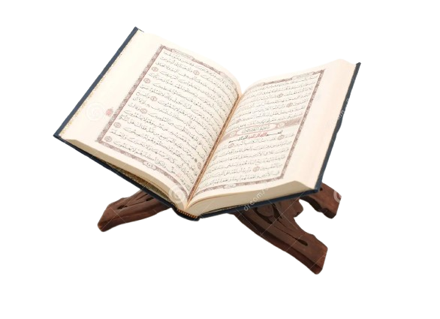
Wuzoo in the Holy Qur’an
“O ye who believe! when you stand up for Prayer, wash your faces, and your hands up to the elbows, and pass your wet hands over your heads, and wash your feet to the ankles.” (5:7)

Slide 4

Ahadith
The Holy Prophet Muhammad^{(pbuh)} said:
“The key to paradise is Salaat, and the key to Salaat is Wuzoo.”
(Jamey‘ al-Tirmidhi, The Book on Purification)
“Shall I not tell you of that by means of which Allah erases sins and raises (people) in status? Doing Wuzoo properly even when it is inconvenient, taking many steps to the mosque and waiting for one prayer after another.”
(Sunan an-Nasa‘i, Hadith 143)

Slide 5
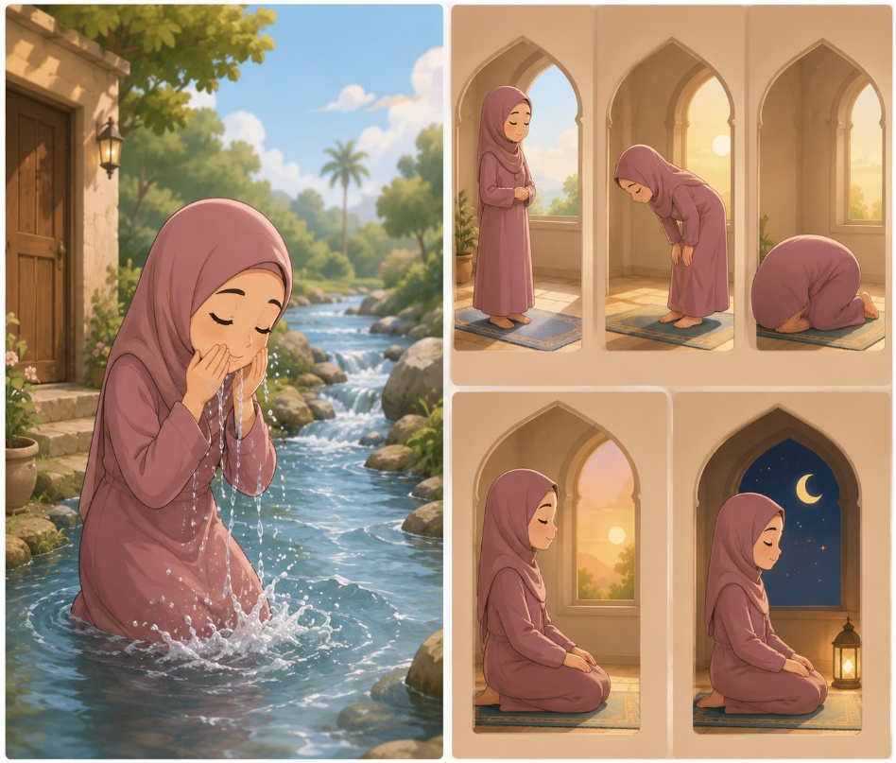
Wuzoo highlights the essential connection between physical cleanliness and our spiritual health.
Having a clean body as well as a clean mind is an essential part of our Salaat.
→ Before we stand to perform Salaat, we should remove all bad thought and feelings, as well as perform Wuzoo (ablution).
The Holy Prophet Muhammad^{(pbuh)} said to his companions:
"If there was a river at the door of anyone of you and he took a bath in it five times a day, would you notice any dirt on him?" They said, "Not a trace of dirt would be left." The Prophet Muhammad^{(pbuh)} added, "That is the example of the five prayers with which Allah blots out evil deeds.“ (Bukhari)
AI-generated image (ChatGPT)

Slide 6
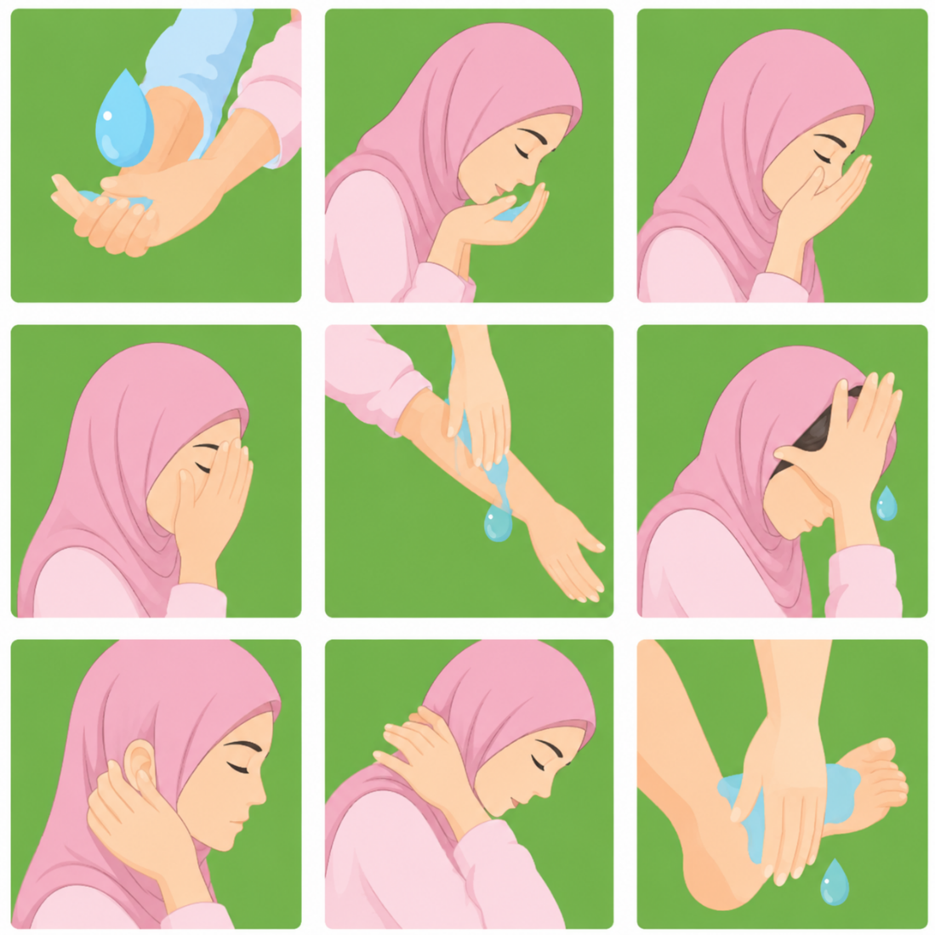

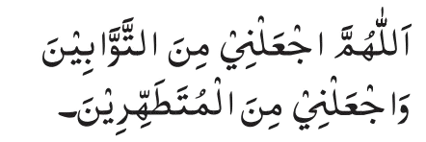
Steps of Wuzoo
Recite
Wash hands with water 3 times up to the wrist, right hand first
Use right hand to rinse mouth 3 times
Rinse nostrils with left hand 3 times
Wash face with both hands 3 times
Wash forearms up to elbows 3 times; right arm first
7. wet hands, using only pinky, ring and middle fingers, pass them over head; run clean index fingers inside ears; with the thumbs, clean back of ears; wipe back of neck with back of hands
8. Wash feet 3 times up to ankles; right foot first
9. Recite prayer after ablution:
Translation:
“O Allah! Make me from among those who repent of their sins and who keep themselves pure and clean.”
AI-generated image (ChatGPT)

Slide 7

Tayyammum
Allah says in the Holy Qur’an that if we are sick or if water is just not available to do Wuzoo, then:
“betake yourselves to pure dust and wipe therewith your faces and your hands.” (5:7)
For us this means that if a clean, dusty surface or a solid surface is available, we should pat the surface with the open palms of both our hands and make a motion with both hands passing them over our face. Then, we should pass the hands over the back of each other.
Side note: If after ablution, one puts on socks, then it is not essential to wash one’s feet for the following 24 hours when one performs ablution. Instead, one should wet one’s hands and after shaking off the excess water, one should pass the hands over both feet on top of the socks.
→ Allah is so merciful and Islam is so beautiful that it provides us Muslims with easy solutions to every problem.

Slide 8
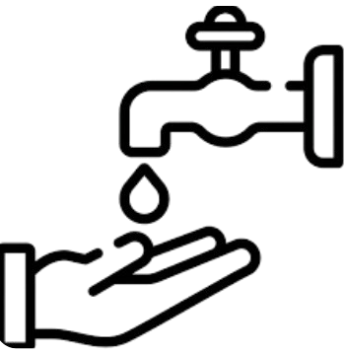


Things That Break Our Wuzoo:
Having to use the bathroom
Passing wind
Sleeping, dozing off while leaning on a support
Becoming unconscious
Getting your blood drawn
Vomiting

Slide 9

The Purpose Behind Wuzoo
Physical cleanliness
Spiritual purification
Symbolic cleansing before meeting Allah in Salaat
Preparation for prayer
Increased mindfulness and focus
Habitual discipline
Obedience to Allah

Slide 10
Benefits of Wuzoo
Studies have shown that through washing certain body parts during Wuzoo, diseases can be prevented and overall health can be improved:
Performing Wuzoo refreshes our skin by removing dust, sweat and oils from skin; a clean outside layer of skin can help the cells underneath function properly.
When washing our face, we cleanse our eyes which can prevent certain eye diseases.
Washing our mouth during Wuzoo removes any food particles from our teeth, tongue, and gums, and can prevent oral health issues. It also gets rid of bad mouth odor.
Rinsing nostrils prevents any germs from entering the respiratory system and hence can prevent diseases and infections.
Rinsing the insides and outsides of our ears during ablution removes the extra wax layer and can prevent certain ear infections.
https://www.islamicfinder.org/news/7-proven-health-benefits-of-ablution/

Slide 11
Benefits of Wuzoo (Continued)
Washing between our toes and fingers removes those germs and bacteria that stay well-hidden otherwise.
There are three major veins in our elbows connected to our brain, heart, and liver, and putting pressure on them during Wuzoo improves blood flow and improves physical and mental strength.
There is a major vein between the back of the head and neck which connects the spinal cord. There are several nerves passing through that major nerve which spreads throughout the body. So wiping the head can regulate blood pressure and improve mental health.
https://islamonline.net/en/the-preventive-and-healing-wonders-of-ablution/

Slide 12
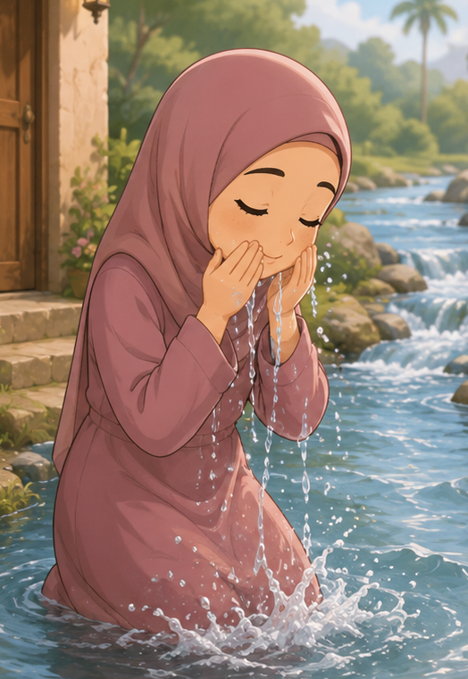

Wuzoo is a therapeutic experience, especially for those suffering from depression.
Nowadays, several yoga experts encourage to perform rituals like Wuzoo before going to bed, saying it relaxes our mind and bodies, ensuring a good night’s sleep.
Did you know?
The Holy Prophet Muhammad^{(pbuh)} also encouraged performing Wuzoo before going to bed.
https://islamonline.net/en/the-preventive-and-healing-wonders-of-ablution/

Slide 13

Conserve Water!
Remember that even though Wuzoo is supposed to be performed properly at least 5 times daily, we should not waste water!
The Holy Prophet Muhammad^{(pbuh)} revolutionized conservation by teaching:
"Do not waste water, even if you perform your ablution on the banks of an abundantly-flowing river." (Sunan Ibn Majah)
Remember: Leaving taps running unnecessarily during Wuzoo contradicts the core principles of Islam:
“…surely, He [Allah] does not love those who exceed the bounds. (Holy Qur’an, 7:32)

Slide 14
Resources:
https://alislam.org/quran/app/5:7
https://www.alislam.org/book/salat/ablution/
https://sunnah.com/bukhari:528
https://lessonislam.org/step-by-step-wudu-guide-complete-islamic-ablution-for-perfect-prayer/?utm_source=chatgpt.com
https://tahiracademy.org/wp-content/uploads/2023/02/TA-Workbook-L2-Release-2022.pdf
https://www.islamicfinder.org/news/7-proven-health-benefits-of-ablution/
https://islamonline.net/en/the-preventive-and-healing-wonders-of-ablution/

