Slide 1

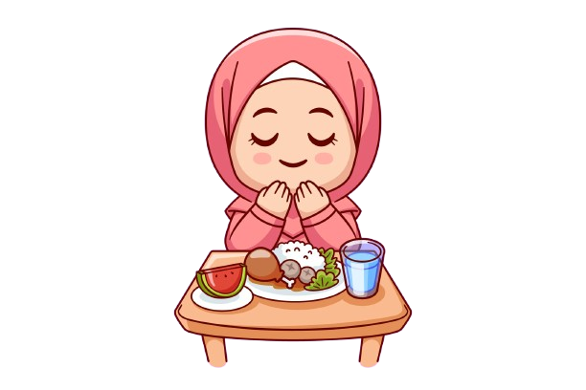
Benefits of
Fasting

Slide 2

‘O ye who believe! Fasting is prescribed for you, as it was prescribed for those before you, so that you may become righteous.’
(Holy Qur’an 2:184)

Slide 3
How Does Fasting Help Us With
Spirituality?
Fasting helps us become fit, patient and helps us bear hardship
It also helps us feel the pain of others and develop sympathy for them
When Muslims keeps away from eating and drinking, they distant themselves from worldly connections, which naturally draws them nearer to spiritual things

Slide 4

But what about the physical benefits of fasting?
So we know that fasting helps with our spiritual well-being.

Slide 5

“And fasting is good for you, if you only knew.”
(The Holy Qur’an, 2:185)

Slide 6
Today, many scientists also acknowledge that a once-a-year diet-control is beneficial for human health
Intermittent fasting (not eating for 14-16 hours of the day, or only eating on alternate days) is becoming more and more popular as a weight loss and health improvement strategy, especially due to the rise of social media
BUT interestingly, as we know, Allah had already introduced a similar fasting pattern, almost 1400 years ago (the fasting from sunrise to sunset during the month of Ramadan)

Slide 7

Some physical benefits of fasting according to scientific studies:
Fasting can reduce the risk of cancer
Fasting can help reduce body weight and decrease the chance for obesity
Fasting can help with prevention of Type 2 diabetes and insulin resistance
Fasting can improve blood pressure and prevent other
cardiovascular diseases
Fasting can boost memory in humans
.

Slide 8
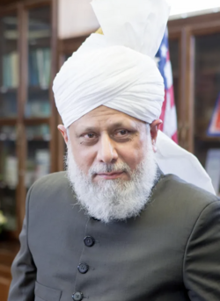
These are just some facts related to fasting, for us to learn, appreciate
and tell others about the beautiful teachings of Islam.
But remember that children are not supposed to fast:
“Fasting becomes compulsory upon you when you have fully matured. If you are a student and you are sitting for your exams and you are 13, 14 or 15 years of age, then you should not fast. If you are able to bear them, then fasting at the age of 15 or 16 is also fine.”
(Hazrat Mirza Masroor Ahmad, Khalifatul Massih V^{aba})

Slide 9
Resources: https://www.alislam.org/articles/fasting-cleansing-soul/ https://www.alislam.org/friday-sermon/2013-07-12.html https://en.wikipedia.org/wiki/Intermittent_fasting https://www.alhakam.org/benefits-of-fasting-spiritual-and-physical-health/ https://www.hopkinsmedicine.org/health/wellness-and-prevention/intermittent-fasting-what-is-it-and-how-does-it-work https://www.alislam.org/question/at-what-age-should-one-start-observing-compulsory-fasting/

